Slide 1

Design and Analysis of Algorithms

Slide 2
Reductions
The class NP-complete (NPC) problems consists of a set of decision problems (a subset of class NP) that no one knows how to solve efficiently.
But if there were a polynomial solution for even a single NP-complete problem, then every problem in NPC will be solvable in polynomial time.
For this, we need the concept of reductions.

Slide 3
Polynomial Reductions
Given two problems A, B, we say that A is polynomially reducible to B (A ≤_{p} B) if:
There exists a function f that converts the input of A to inputs of B in polynomial time
A(i) = YES ⇔ B(f(i)) = YES

Slide 4
Polynomial Reduction
Polynomial time algorithm to decide A
yes
α
f
β
Polynomial time
algorithm to decide B
yes
no
no
Use a polynomial time reduction algorithm to
transform A into B
Run a known polynomial time algorithm for B
Use the answer for B as the answer for A

Slide 5
Implications of Reduction
Problem A reduces to problem B if you can use an algorithm that solves B to help solve A.
Cost of solving A = total cost of solving B + cost of reduction.
yes
α
f
β
Problem B
yes
no
no
- If A ≤_{p} B and B ∈ P, then A ∈ P
- if A ≤_{p} B and B ∉ P, then A ∉ P
Algorithm for Problem A

Slide 6
Reductions Examples
Problem A reduces to problem B if you can use an algorithm that solves B to help solve A.
Example 1. [finding the median reduces to sorting]
To find the median of N items:
Sort N items
Return item in the middle:
Cost of solving finding median = O(n log n) + 1
yes
α
f
β
Problem B
yes
no
no
Algorithm for Problem A
Cost of Sorting
Cost of Reduction

Slide 7
Reductions Examples
Problem A reduces to problem B if you can use an algorithm that solves B to help solve A.
Example 2. [element distinctness reduces to sorting]
To solve element distinctness on N items:
Sort N items
Check adjacent pairs for equality.
Cost of solving element distinctness = O(n log n) + O(n)
yes
α
f
β
Problem B
yes
no
no
Algorithm for Problem A
Cost of Sorting
Cost of Reduction

Slide 8
Reductions Examples
Convex hull. Given N points in the plane, identify the extreme points of the convex hull (in counterclockwise order).
Example 3. [Convex hull reduces to sorting.]
To solve convex hull:
Choose point p with smallest (or largest) y-coordinate.
Sort points by polar angle with p.
Consider points in order, and discard those that would create a clockwise turn.
Cost of solving element distinctness = O(n log n) + O(n)
yes
α
f
β
Problem B
yes
no
no
Algorithm for Problem A
Cost of Sorting
Cost of Reduction

Slide 9
RECIPE FOR PROVING PROBLEM Is NP-Complete
To Prove B Is NP-Complete
Prove that B is a member of the class NP. B ∈ NP
Choose an NP-complete problem A.
Prove that there is a reduction from A to B.

Slide 10
Reductions
Suppose there are two problems, A and B.
And you know that it is impossible to solve problem A in polynomial time because no one has been able to solve it.
You want to prove that other problem B cannot be solved in polynomial time.
How would you do this !

Slide 11
Reductions
You want to prove that B cannot be solved in polynomial time.
One approach is to find polynomial time algorithm for B. It would take a lot of time even years. And when you are unable to find then you say that B is not solvable in polynomial time. This is not good approach.
Right approach would be if you think that B seems similar as that of A which means that you can reduce A to B or B to A then you can say B is also not solvable in polynomial time because it is known that A is not solvable in polynomial time

Slide 12
Reductions
Example :
Consider a well known NPC problem (graph coloring problem) given below :
3-color: Given a graph G, can each of its vertices be labelled with one of 3 different colors such that no two adjacent vertices have the same label (color).
You can say that the task is to determine if the graph can be colored using at most 3 colors such that no two adjacent vertices are given the same color.

Slide 13
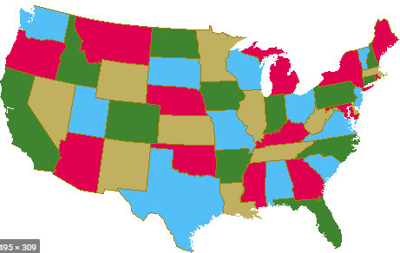
Reductions
It is well known that planar graphs can be colored (maps) with four colors. There exists a polynomial time algorithm for this. But determining whether this can be done with 3 colors is hard and there is no polynomial time algorithm for it.
Real life application of graph coloring arises in various partitioning problems where there is a constraint that two objects cannot be assigned to the same set of partitions.
For example, two countries that share a common border should be colored with different colors. For example, there would be edge between countries if they share border.
Given diagram is example of 4 graph coloring of map of states of USA

Slide 14
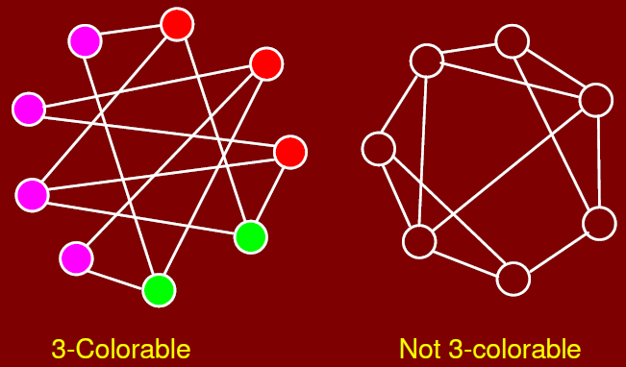
Reductions

Slide 15
APPLICATIONS
the vertices of a graph represent academic classes, and two vertices are adjacent if the corresponding classes have people in common, then a coloring of the vertices can be used to schedule class meetings. Here the colors would be schedule time.
If the vertices of a graph represent radio stations, and two vertices are adjacent if the stations are close enough to interfere with each other, a coloring can be used to assign non-interfering frequencies to the stations.
If the vertices of a graph represent traffic signals at an intersection, and two vertices are adjacent if the corresponding signals cannot be green at the same time, a coloring can be used to designate sets of signals than can be green at the same time.

Slide 16
Reductions
Consider another real life application of graph coloring in “Fish Tank”.
A tropical fish hobbyist has six different types of fish designated by A, B, C, D, E, and F, respectively.
Because of predator-prey relationships, water conditions and size, some fish can not be kept in the same tank.

Slide 17
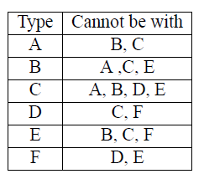
Reductions
The following table shows which fish cannot be together:
For example. Fish A cannot be with Fish B and C. Fish B cannot be with A,C and E.
The question is how many minimum tanks are required for this ?

Slide 18
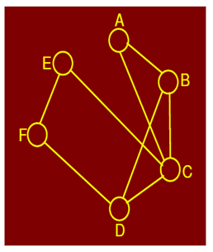
Reductions
Now lets convert this fish tank problem into graph problem. Like Fish will be represented by vertices.
The answer can be found by coloring the vertices in the graph such that no two adjacent vertices have the same color.
These constraints can be displayed as a graph where an edge between two vertices exists if the two species cannot be together in same tank. This is shown in figure:
For example: As there is edge from A to C means A and C cannot be in
same tank. B cannot be with A,D, C and so on..
Can we color this graph with three different colors !

Slide 19
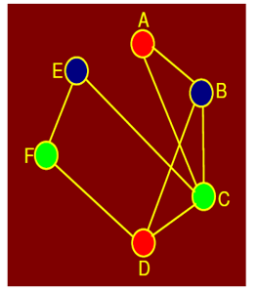

Reductions
Fish tank graph colored with three different colors :
Yes this is possible with 3 colors (means 3 different tanks). The 3 fish tanks will hold fish as follows:

Slide 20
Reductions
So what have we done till now ! We saw a problem, we made strategy to solve it means we converted it to graph problem and to convert it into graph problem, we also decided what would be edges and vertices.
Like in case of map of states of USA. Vertices could be states and edges mean there is a border. In case of fish tank problem, vertices are fish and edges mean these fish cannot be together.
Now as we have mapped these problems into graphs so now we can use algorithms that are available for solving graphs so we used graph coloring.
However there is no polynomial time algorithm to identify that given graph is 3 colorable or not! But you can verify if solution is given. The problem of 3-colorable graph is NP-complete.

Slide 21
Reductions
So 3-color graph problem is NP-complete. Lets say this 3-color graph problem is problem A.
Now we take another problem B. We have doubt that this problem B is also NP-complete. If we can reduce problem A (3-color graph problem) into problem B then we can say that B is also NP-complete. So by this way, we can save a lot of time by not wasting time in finding polynomial time solution of B and rather we would say that B is NP-complete and not solvable.

Slide 22
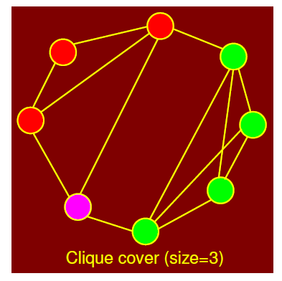
Reductions
Consider the following problem as problem B :
Clique is a group of vertices such that sub-graph form through these vertices is complete.
Complete means if sub-graph has vertices (V1,V2,V3,V4) then among these four vertices, there is edge from every vertex to every other. Below figure shows graph that has clique cover size of 3 which means that there are 3 sub-graphs that are complete.

Slide 23
Reductions
The clique cover problem arises in applications of clustering.
We put an edge between two nodes if they are similar enough to be clustered in the same group.
We want to know whether it is possible to cluster all the vertices into k groups.

Slide 24

Reductions
You know that 3Col (3 coloring graph) is NP-complete and hence, experts believe that 3Col does not belong to P class. You feel that there is some connection between the CCov problem (Clique Cover) and the 3Col problem. Thus, you want to show that

Slide 25
Reductions
Both problems (3Col and CCover) involve partitioning the vertices into groups.
In the clique cover problem, for two vertices to be in the same group, they must be adjacent to each other.
In the 3-coloring problem, for two vertices to be in the same color group, they must not be adjacent.
In some sense, the problems are almost the same but the adjacency requirements are exactly reversed.

Slide 26
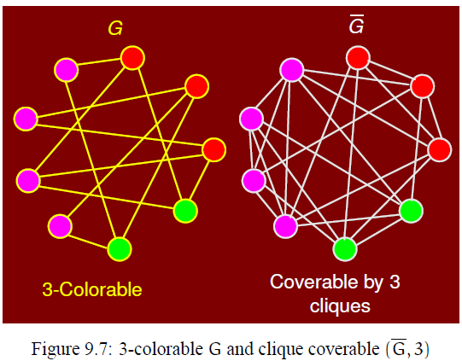
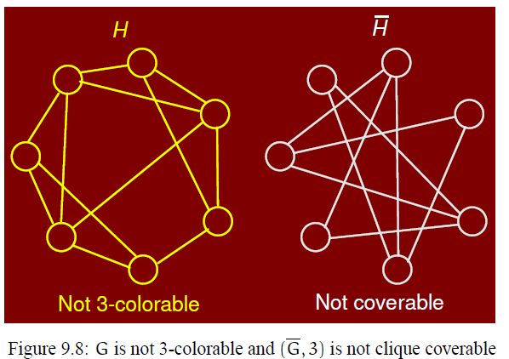
Reductions

Slide 27

Reductions
So we reduced 3Col problem to 3CCover problem and this reduction can be done in polynomial time. For example, to take complement of graph, you can change 1 with 0 and 0 with 1 in adjacency matrix of graph in O(n^2) time.
So you can say that you have reduced 3Col problem into Ccover problem in polynomial time which can be written as:
Note that reduction must be done in polynomial time. So finally we can say that as we can reduce 3Col problem into Ccover problem in polynomial time so Ccover is also NP-Complete problem.

Slide 28
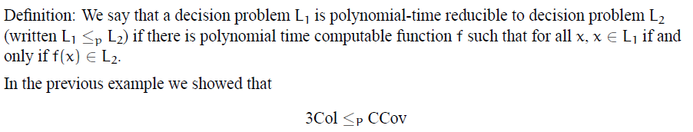
Reductions
Polynomial time reduction can be defined as :

